Slide 1
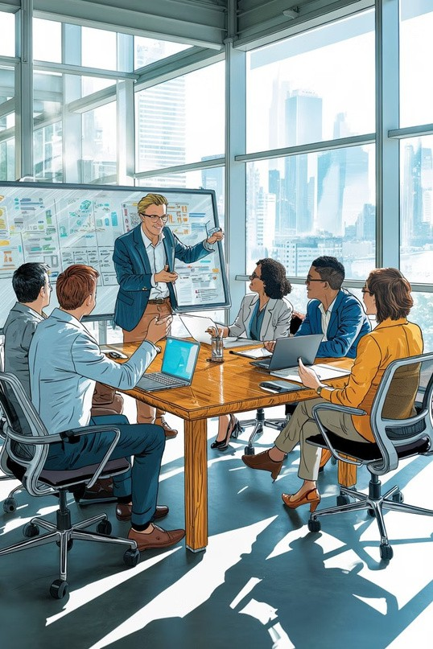
First Team Meeting – May 10, 2026
Team Introduction Session
Welcome everyone to our first official team gathering. Today marks the beginning of an exciting journey where we'll introduce ourselves, share our expertise, and align on our collective vision. This session is designed to help us understand each other's strengths, working styles, and how we can best collaborate to achieve our goals.

Slide 2
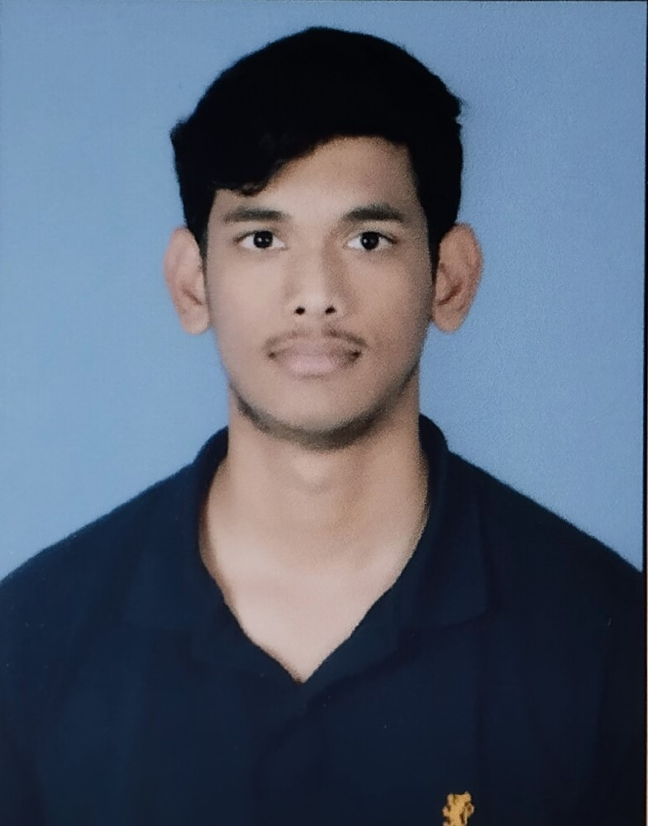

About Me
Kontham Jagan Mohan Reddy
Full stack web developer/Machine Learning Developer
I am a B.Tech Computer Science and Engineering (CSE) student at Sphoorthy Engineering College with a strong interest in Web Development and Machine Learning. I enjoy building projects. I am passionate about learning new technologies, exploring innovative ideas, and creating solutions that solve real-world problems.
Key interests:
Web Development
Machine Learning & AI

Slide 3
Skills & Expertise
Core technical capabilities that define my professional toolkit and enable me to contribute effectively to team projects.
AI & Machine Learning
Currently learning Machine Learning and Deep Learning technologies while exploring their real-world applications and building practical projects to strengthen my understanding.
Frontend Development
Worked on multiple projects that significantly enhanced my frontend development skills and strengthened my understanding of creating modern, responsive, and user-friendly web applications.
Backend Engineering
Skilled in backend development using Node.js, Express.js, REST APIs, and Mongo DB, with experience in building scalable and efficient web applications.
Database Systems
Experienced in working with databases like MongoDB and SQL for storing, managing, and handling application data efficiently in web development projects.
Prompt Engineering
Experienced in crafting effective AI prompts to generate accurate, creative, and optimized responses for different use cases and applications.
AI Tools & Platforms
Experienced in using AI tools and platforms such as Anthropic Claude, ChatGPT, Antigranity, and other AI-powered tools for productivity, content generation, learning, and development purposes.

Slide 4
Key Achievements
Practical experiences and technical learning that helped me improve problem-solving, development skills, and teamwork.
Achievement 1 – IUCEE Winner Recognized as an IUCEE winner for demonstrating innovation, technical skills, and problem-solving abilities.
Achievement 2 – Built Multiple Projects Developed multiple projects in web development and technology domains to enhance practical skills and gain hands-on experience.

Slide 5
Learning & Working Style
My approach to daily work, collaboration preferences,and how I engage with team projects.
Daily Routine
Like learning consistently through practical work, projects, and regular practice.
Focus Style
Able to work effectively under pressure situations while maintaining a calm and peaceful mindset to stay focused and productive.
Collaboration Mode
Prefer working in team environments, collaborating with others, sharing ideas, and contributing effectively toward achieving common goals.
Communication Style
Prefer clear and understandable communication to ensure effective collaboration and smooth workflow.

Slide 6
Vision & Contribution
What I Want to Build
My vision is to build innovative and impactful products that solve real-world problems while creating successful business opportunities and generating significant value.
How I Plan to Contribute
Machine Learning
Full Stack Web Development

Slide 7
Let's Connect
Email
[konthamjaganmohanreddy@gmail.com]
LinkedIn
[www.linkedin.com/in/jagan-mohan-reddy-kontham-445250293]
GitHub
[github.com/11Jagan]
Instagram
[@jagan_.11]
Looking forward to working together and building something great!

